Slide 1
Media Streaming with cloud Video Streaming.

Slide 2
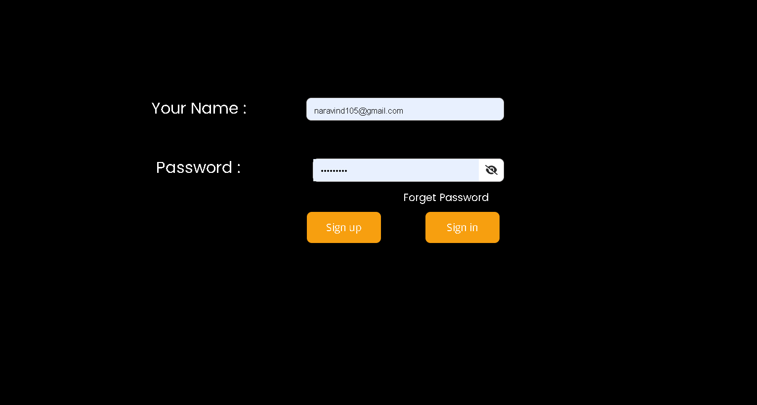
Sign in page:
The Sign in page should have the user name and pass word section to access to the IBM cloud to stream and play videos.
It should also have the Sign up option for the new clients.
Its should also have the forget password field in case if the user forget the password

Slide 3
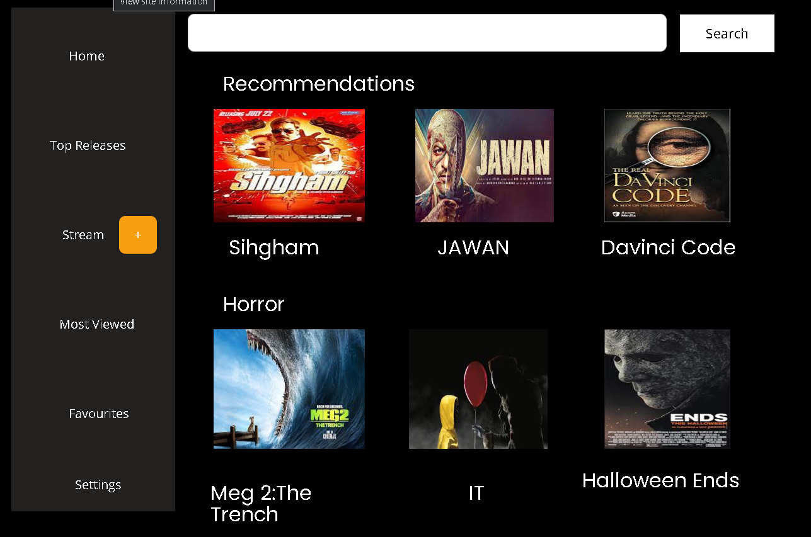
User InterFace :
User should have an Home page to show their recommendations of movie to play from the cloud.
The user will have a start stream button to stream the movie from their local device to the cloud .
The recommendation are used to keep track of the users activities by their watch history.
In the home page there should be a search bar to search movies directly on the cloud space.

Slide 4
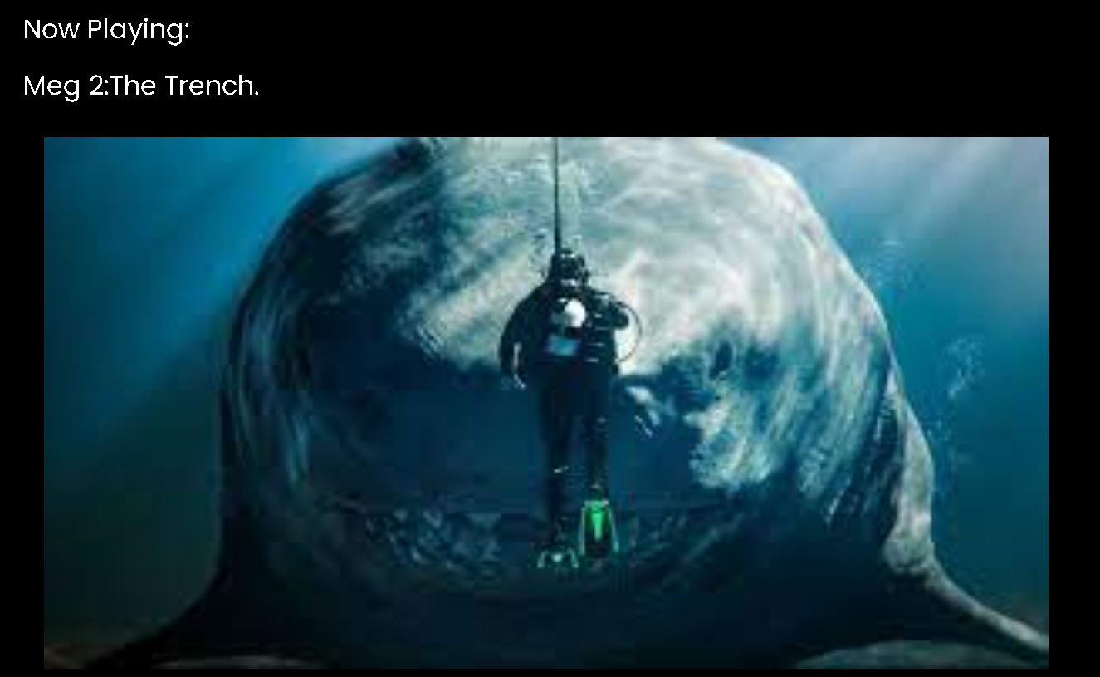
Playing movie:
After selecting the movie to play next ,you can enjoy watching it.
There is no interruption of any third party application .
You can use this application on any devices regardless of mobile phones or computers.

Slide 5
Backend and Cloud Connectivity:
We should store the users details on the database for further any promotion or any other analytics purpose.
We should give an individual access to each and every users out there to provide cloud streaming.
We should also restrict the users to any confidential details of the company or other users.
Here we use IBM cloud to maintain the data of the users which is steadily growing every second.

